Slide 1
Journey PPT
Shell Training
Week 4 – 04/9/2023 to 08/9/2023
Daksh Malik
Associate Data Engineer

Slide 2


Day 1 -
Introduction to Azure Storage
Benefits of Azure Storage
Azure Storage data services
Review options for storing data in Azure
Creating a Container
Blob Configuration
Azure Storage Security

Slide 3
Day 2 -
Azure File Storage
Table & Queue Storage
Azure Disk Storage
Storage Monitoring
Storage Resource Tools

Slide 4
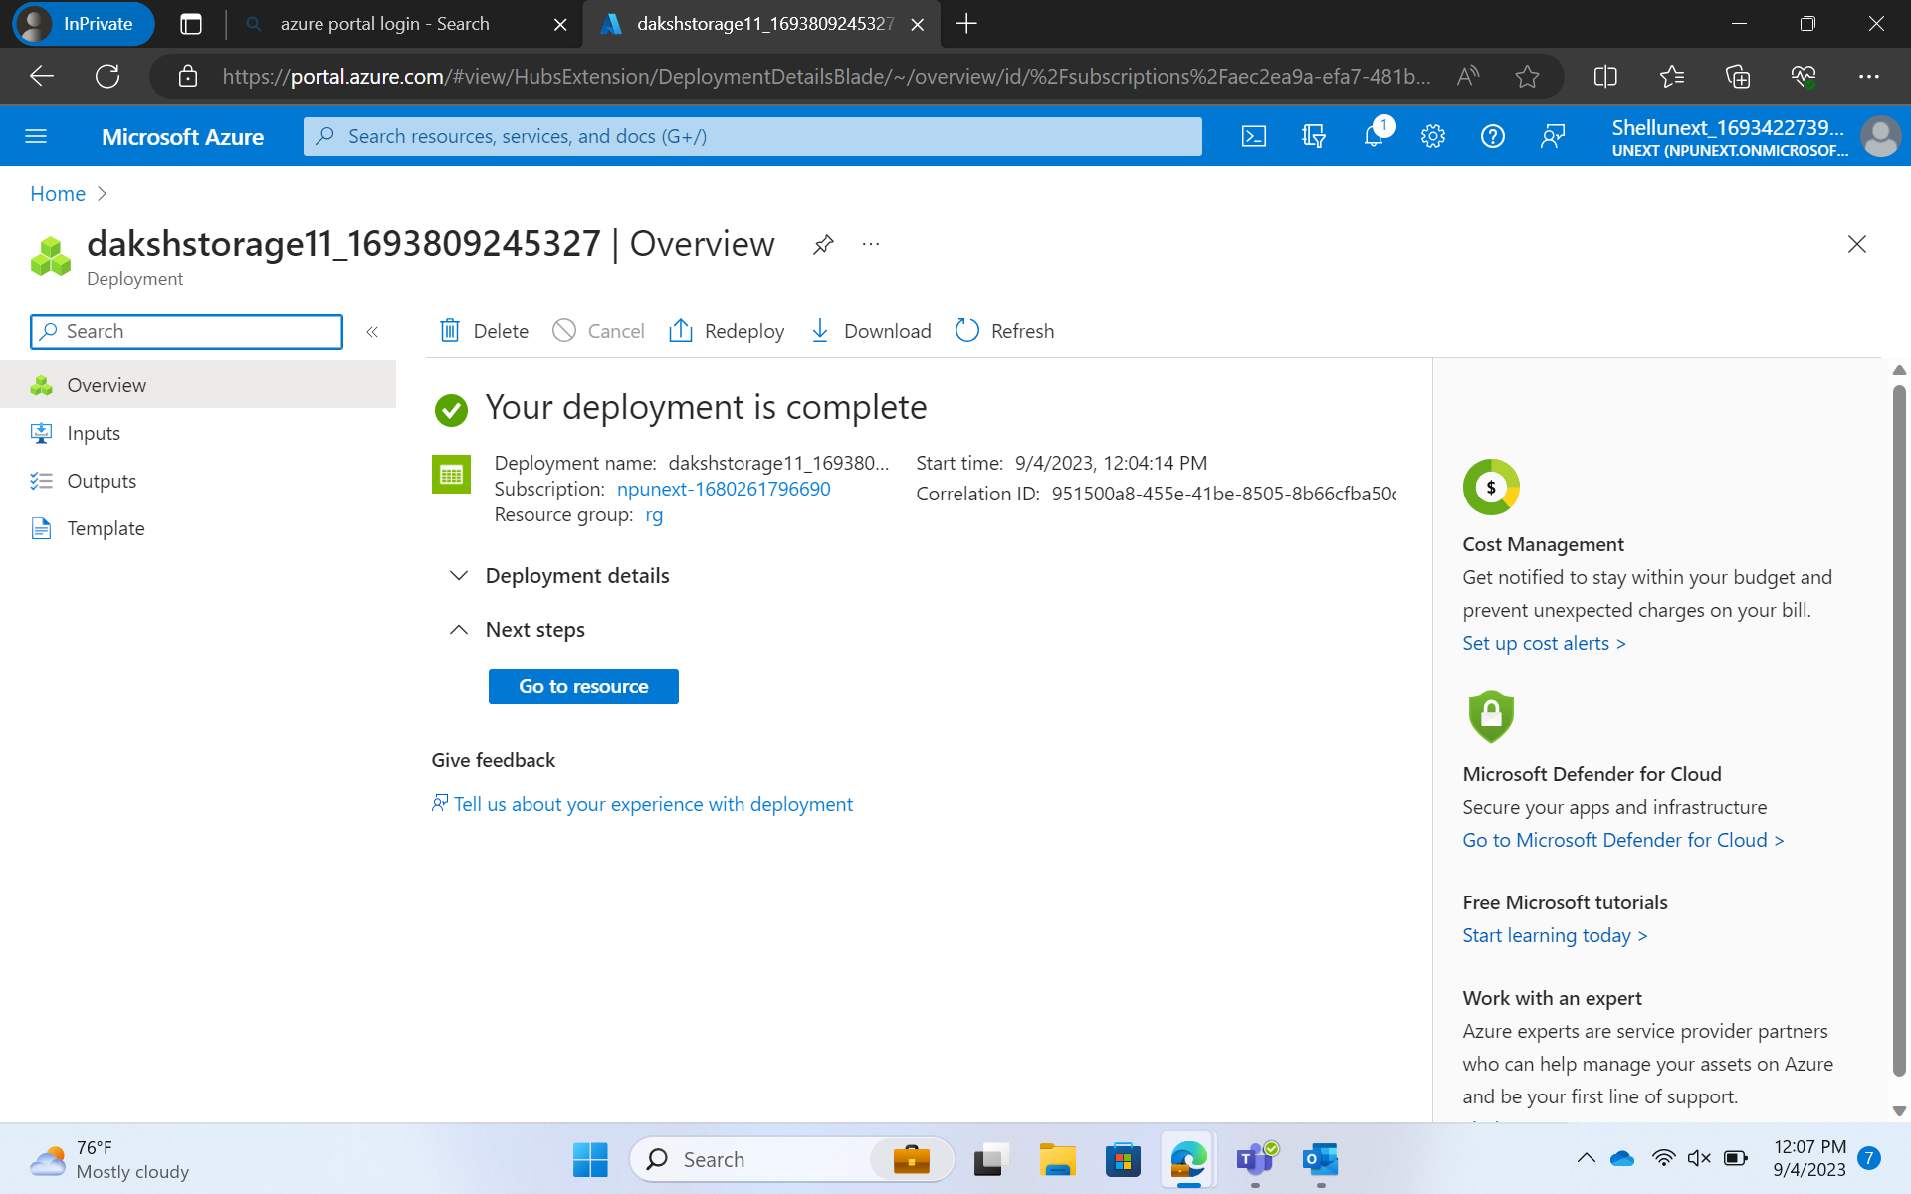

Slide 5
Day 3 -
Azure Data Lake
Input Datasets
Pipeline
Output Datasets
Linked Services

Slide 6
Day 4 -
Control Flow Activity
Get Metadata Activity
Filter Activity
Copy Data
ForEach Loop
If Condition
Parameterization
Derived Column
Join
Conditional Split
Assessment / MCQ Quiz

Slide 7
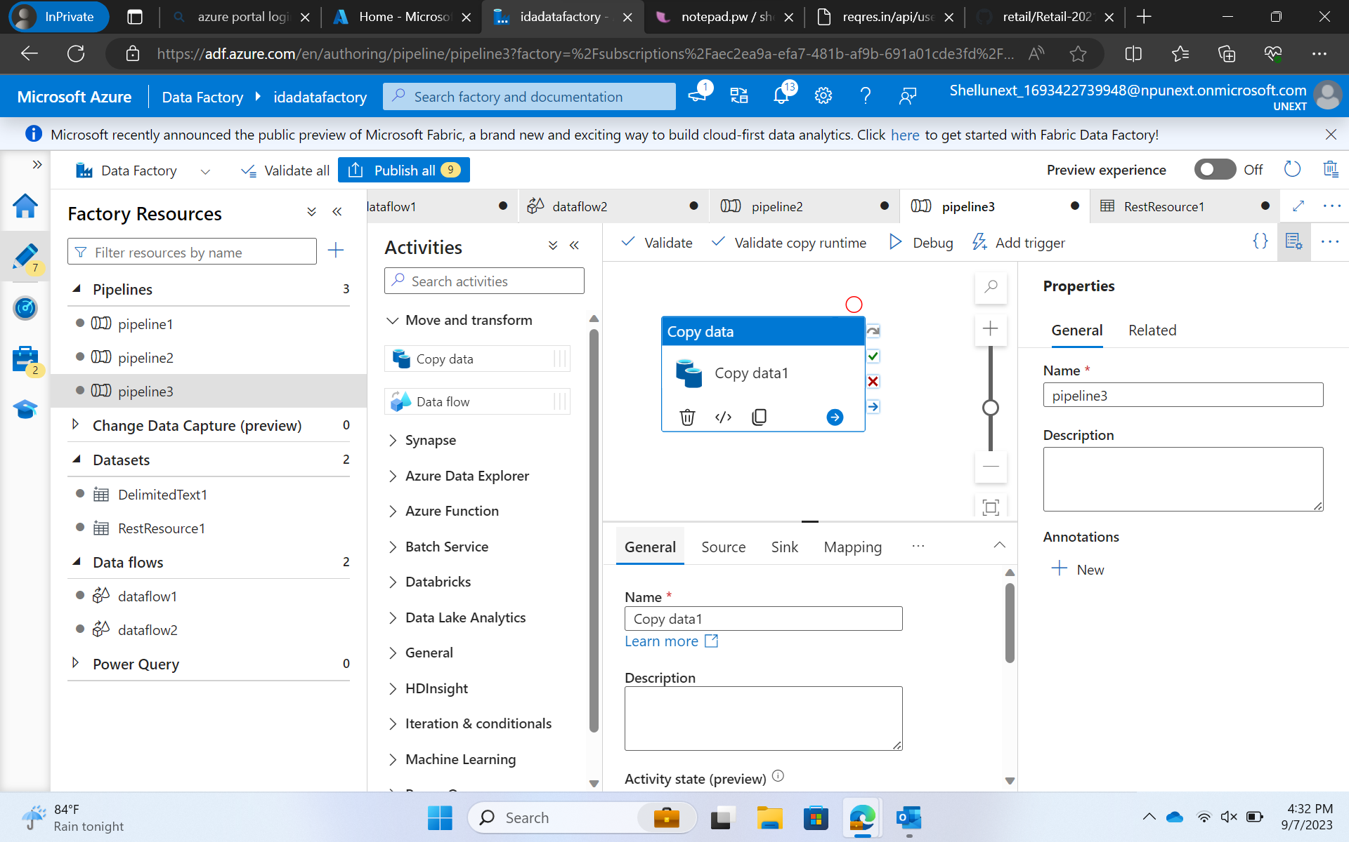

Slide 8
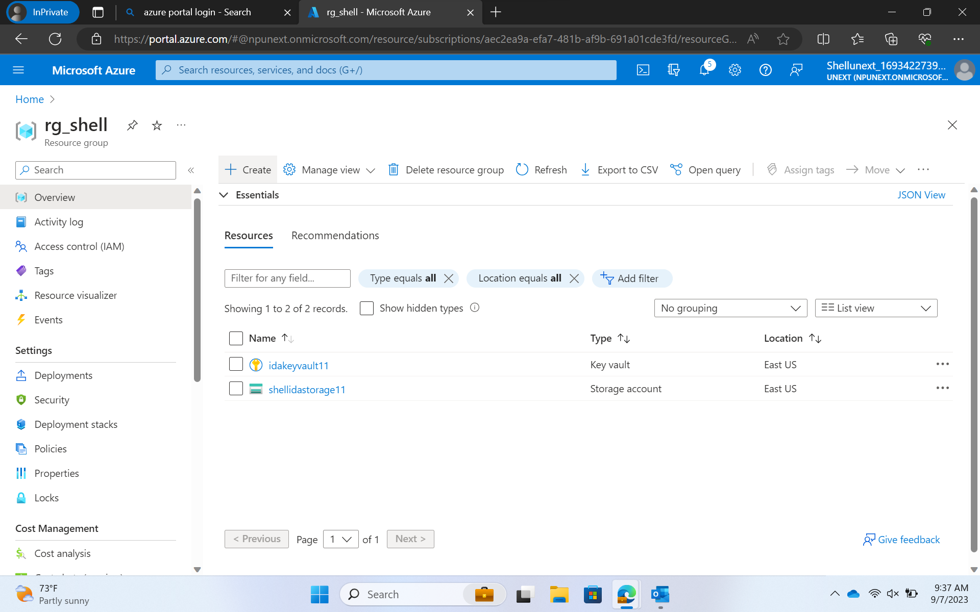

Slide 9
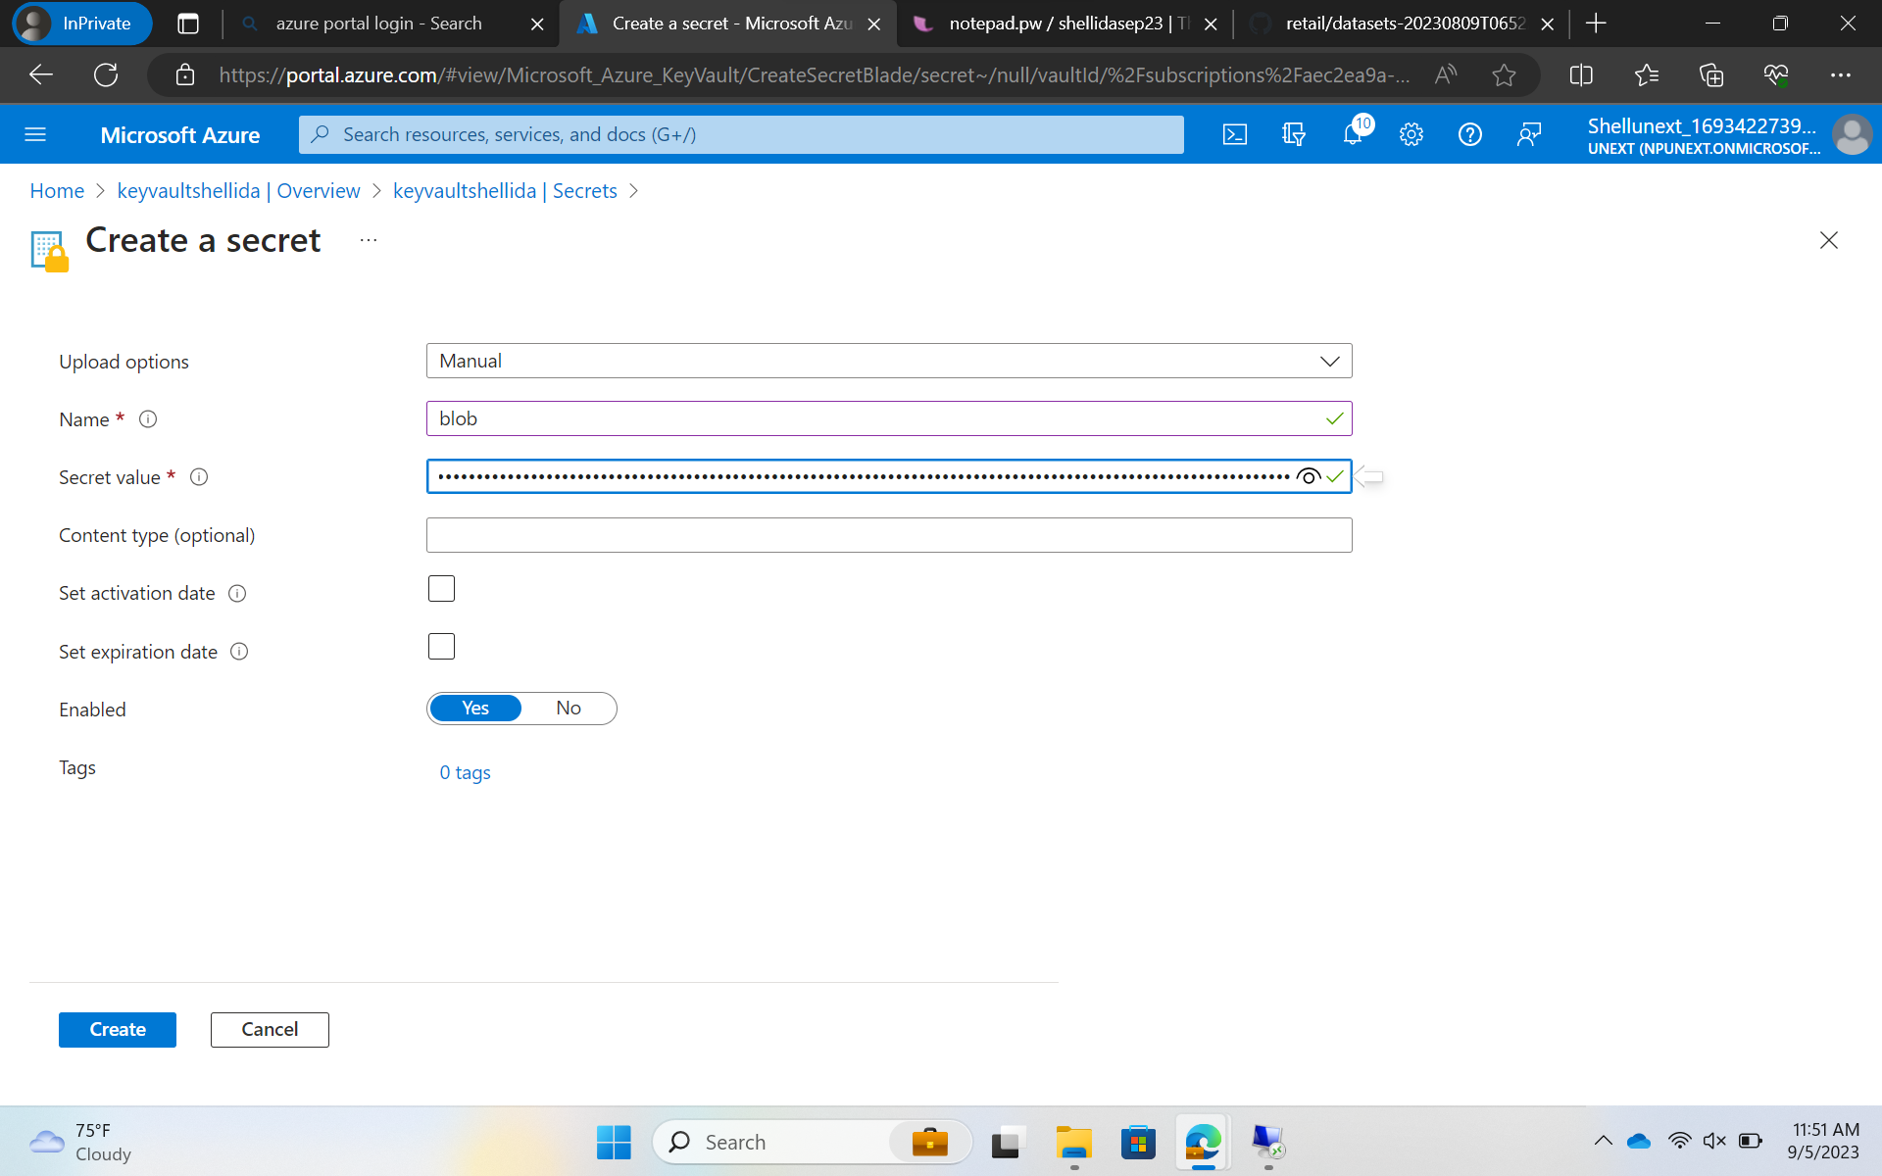

Slide 10
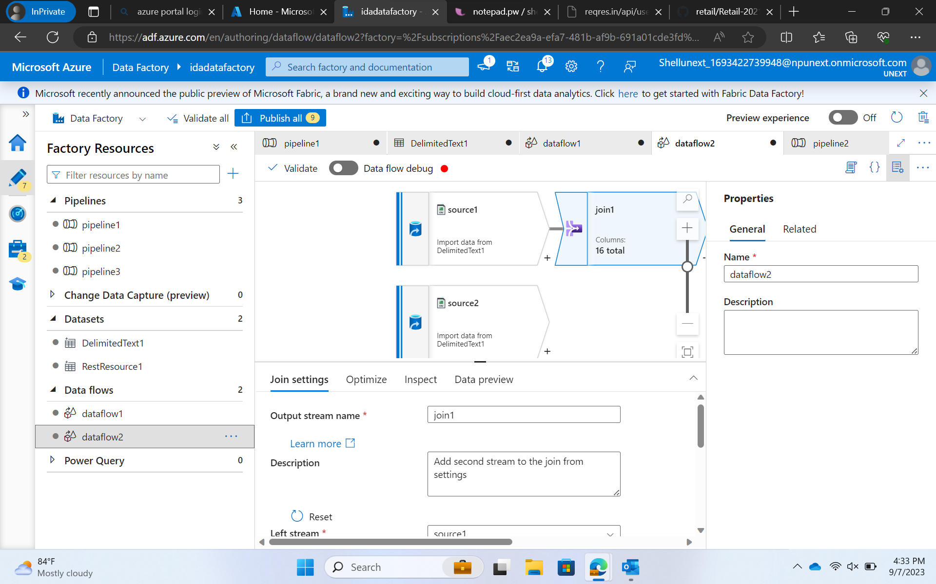

Slide 11
Day 5 -
Mapping data flows in Azure Data Factory
Change data capture in Azure Data Factory
Mapping data flow Debug Mode

Slide 12
Thank you for your time.

